Slide 1
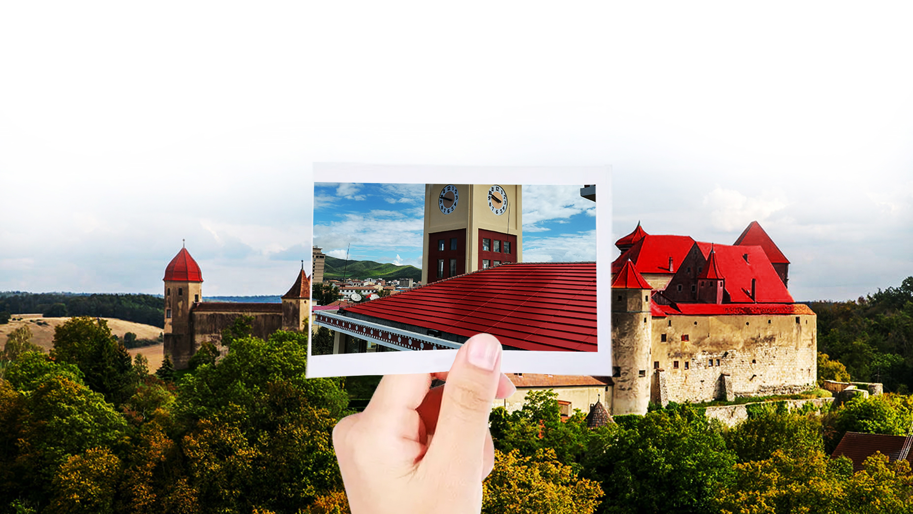
Start with the obsession that seems to have been known before,Always meet in the classic heritage
TangTile
The Most Beautiful Photovoltaic Tile
Green power generation building materials

Slide 2
BIPV
Colorful BIPV PV roof
Let the red classic continue ……

Slide 3
CATALOGUE
1
Main Products
2
Product Showroom
3
Installation Process
4
TangTile System Diagram
5
Application scenarios

Slide 4
Power free, modern and beautiful
Photovoltaic Power
Beautiful Roof
Power Free
TangTile Interpretation (four elements)
Product form
Tile Roof is Stacked On Top Of Each Other
Photovoltaic power performance
Efficient Power
Industry attribute
Roofing Material
Consumption concept
Architectural Integration
Arch form
Tile function
Architectural integration
Efficient photovoltaic power Electricity does not cost money
Building material properties.
Keep the roof beautiful.
Photovoltaic power Generation
Without Destroying the Roof
Replacement of Existing roof
Architectural style integration

Slide 5
BIPV
Product
Positioning
Building photovoltaic integrated nature
Building materials that can generate photovoltaic power
The new generation of BIPV building materials photovoltaic tiles and other building materials products
But more photovoltaic power generation function
And everyone loves it
A New Generation Of Green Building Materials Photovoltaic Tiles
Let thousands of households use a new generation of BIPV building materials photovoltaic tiles
A new generation of BIPV Photovoltaic building materials power generation

Slide 6
surfaces Photovoltaic TangTile
Green power generation building materials
Three arch photovoltaic tile
Extreme aesthetic power generation
Classical roof aesthetic design
Multi-form curved surface power generation
Extreme efficient three-dimensional power generation

Slide 7
Cutting-edge technology
Integration with solar film cells and traditional roof tiles
Transmittance:>91.5%
glass
POE film
miasole cell
POE film
glass
Exquisite craft
Cutting-edge technology
Smart power
Hardness & softness

Slide 8
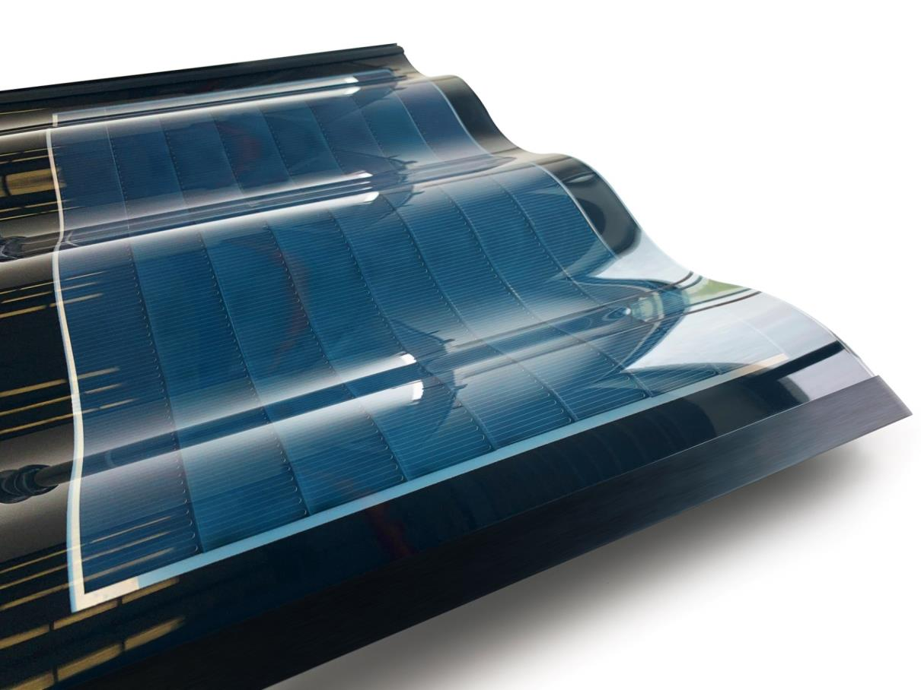
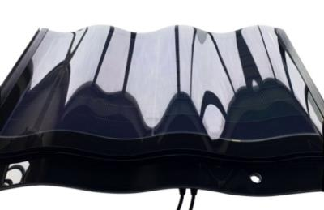
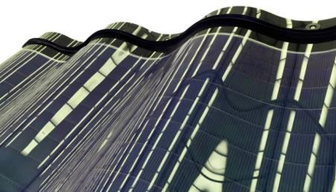
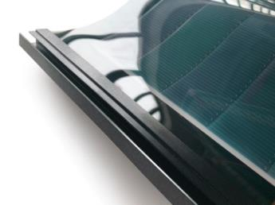
The style of the
Tang
Dynasties
131
Patents
30W
25 Years shelf life
Electrical Data(STC)
Peak Power Watts-Pm [W] | 32/30/28/25(Black）
 | 25/23/21/18(Green/Red）
Component size-L*W*H[mm] | 721*500*33mm
Component weight[kg] | 6.5（±0.5）
Frame | Aluminium alloy
Junction Box | IP67, MC4 connectors
Colour | Grey, Red,Green

Slide 9
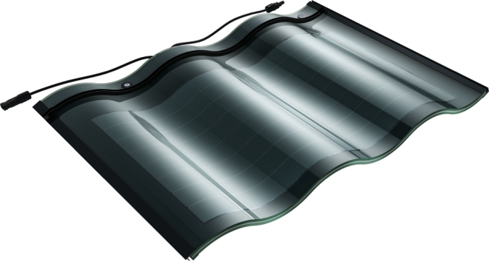
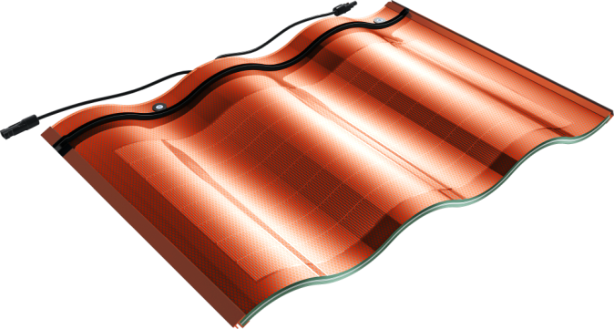
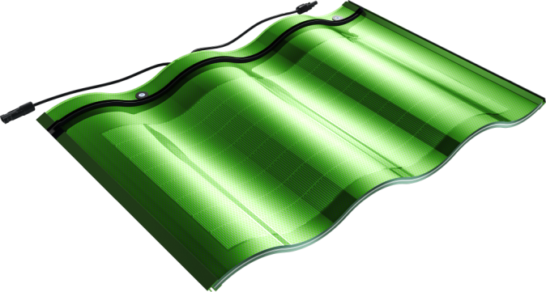
Product color
Adapt to various shapes and styles of design
Black
Red
Green

Slide 10
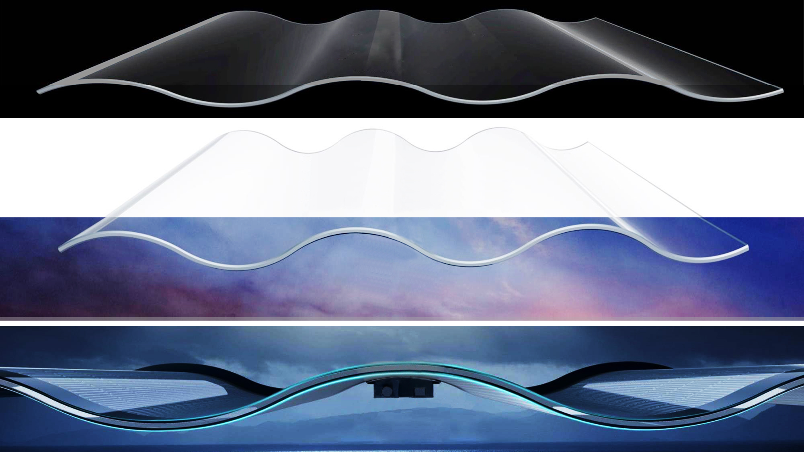
Arch
Product Identification Characteristics
Strong
light
Thin

Slide 11
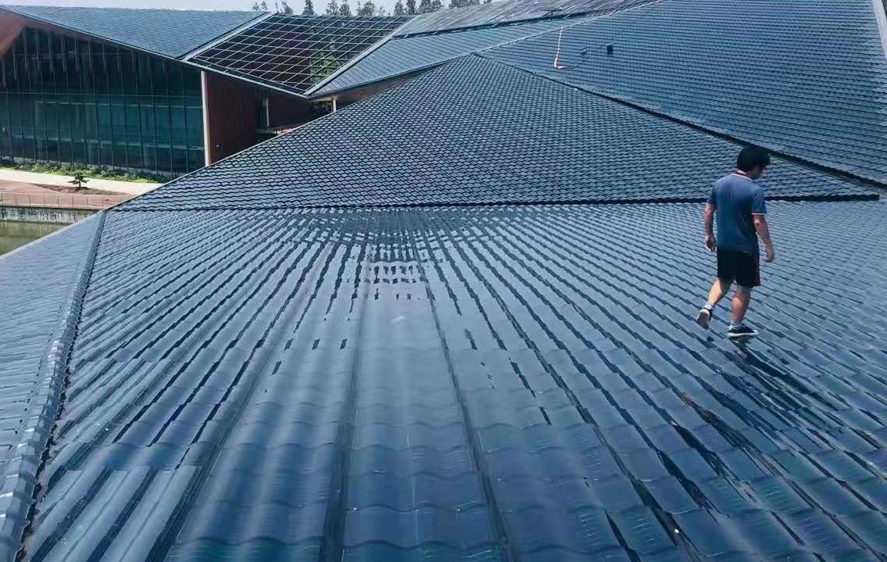
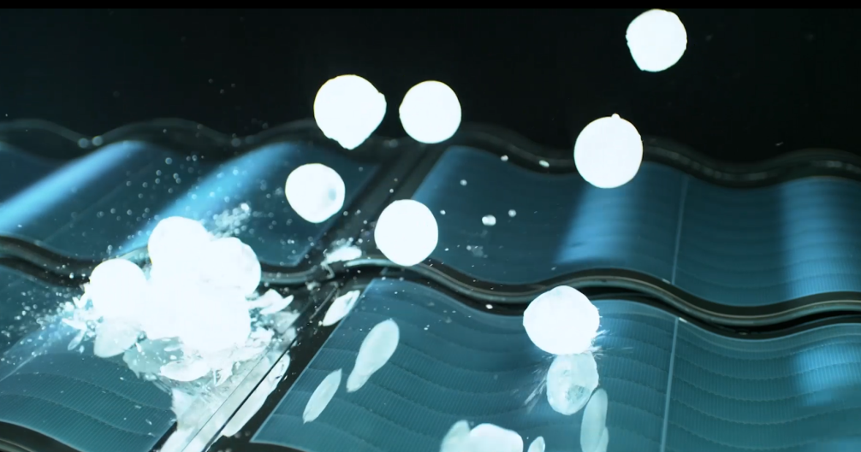
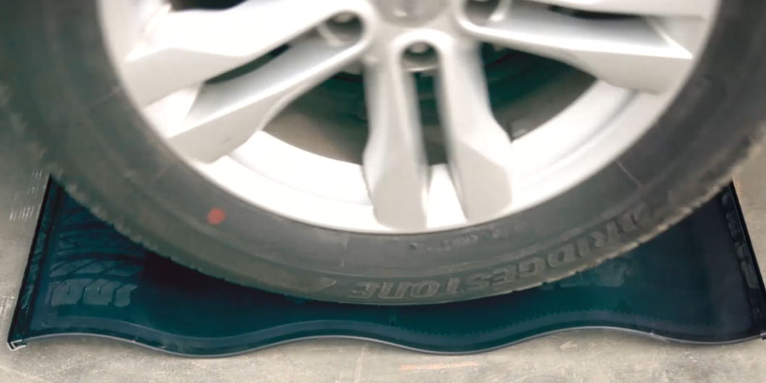
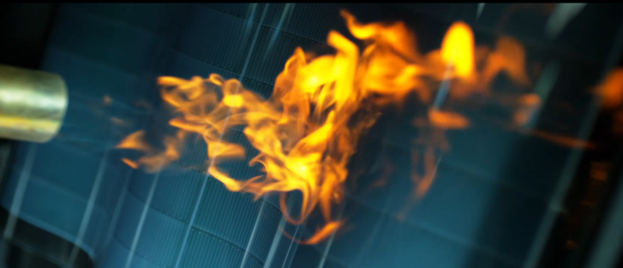
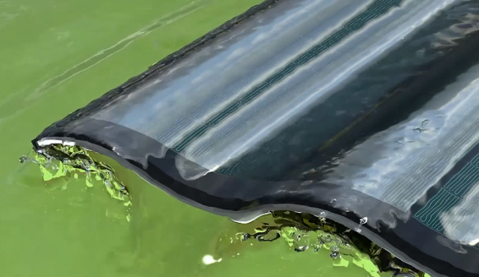
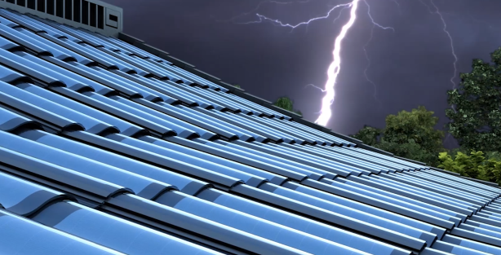
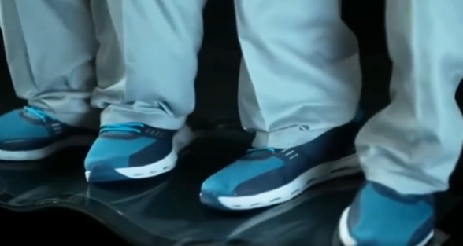
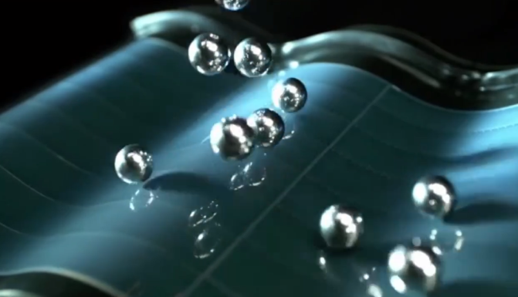
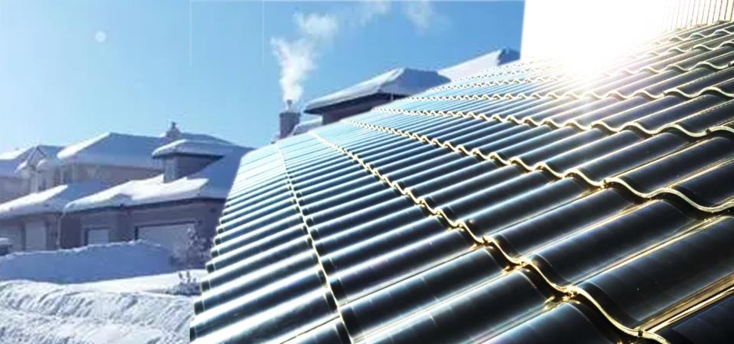
Trample freely
During construction
Resistance to hail
The car was run over and not damaged
Conclusion of product usability test
Class A fire
Waterproofing IP67
Class F wind
Lightning Protection
Multiple trampling test
Ball drop test
Melt snow, no snow
Resistance to external force

Slide 12
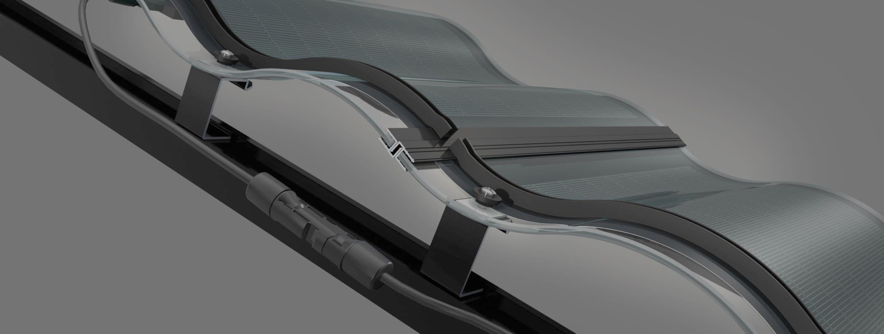
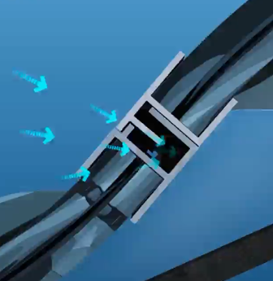
TangTile Rear side ventilation design
The air around TangTile back is heated to expand and rise in working, so air pressure is reduced. The external air flows into it under outside air pressure, forming an external-to-internal air circulation.
System lap Characteristics
Mounting and installation
The construction error will occur in the TangTile installation, which will lead to the failure of the upper and lower arch, then affect its waterproof performance. the production and erection errors can be eliminated by moving left and right adjustment functions.
Withstand 15 typhoons and wind speeds of 177 km/h, Passed by UL certification of USA,

Slide 13
2.Product Howroom
Scene-based display

Slide 14
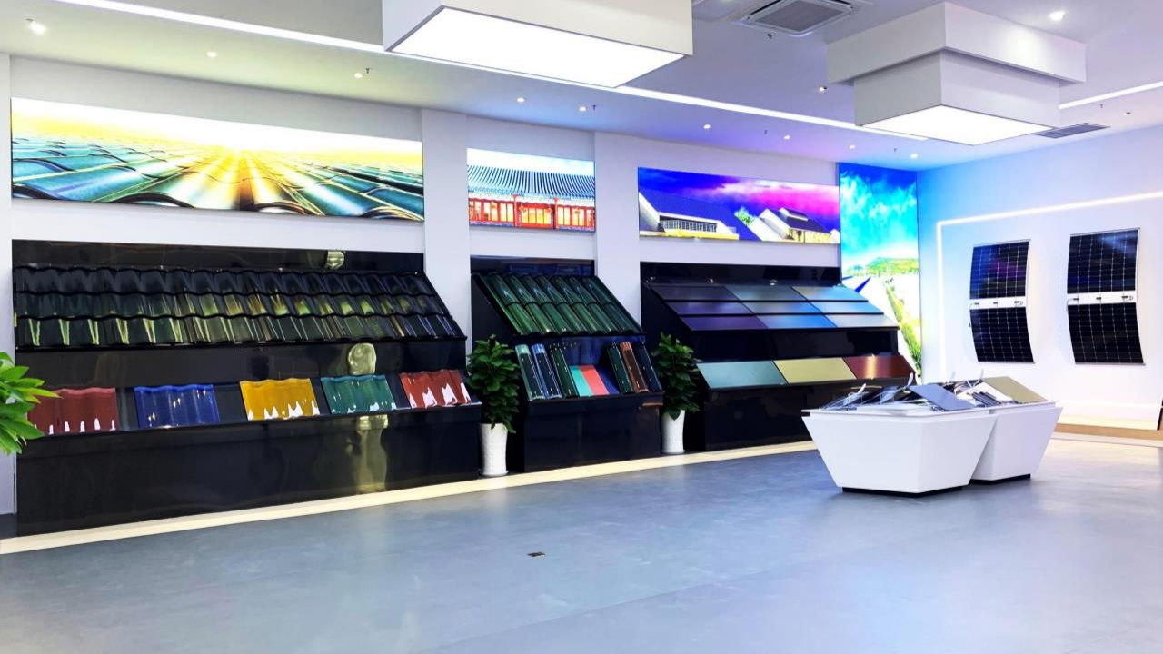
The whole picture of the exhibition hall

Slide 15
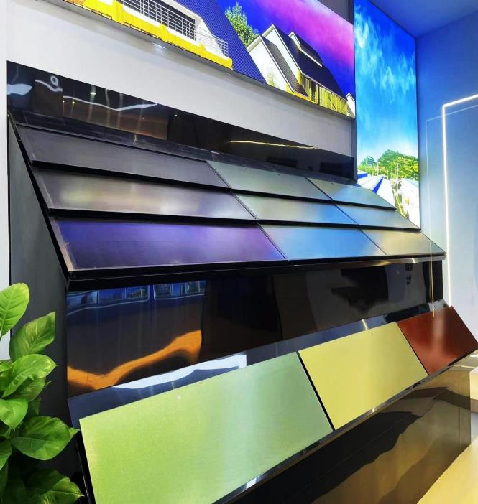
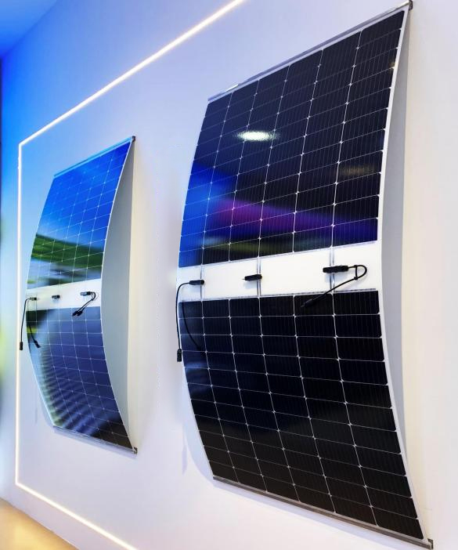
HJT flat-surface and highly efficient power generation tile
HJT high-efficiency and lightweight assembly

Slide 16
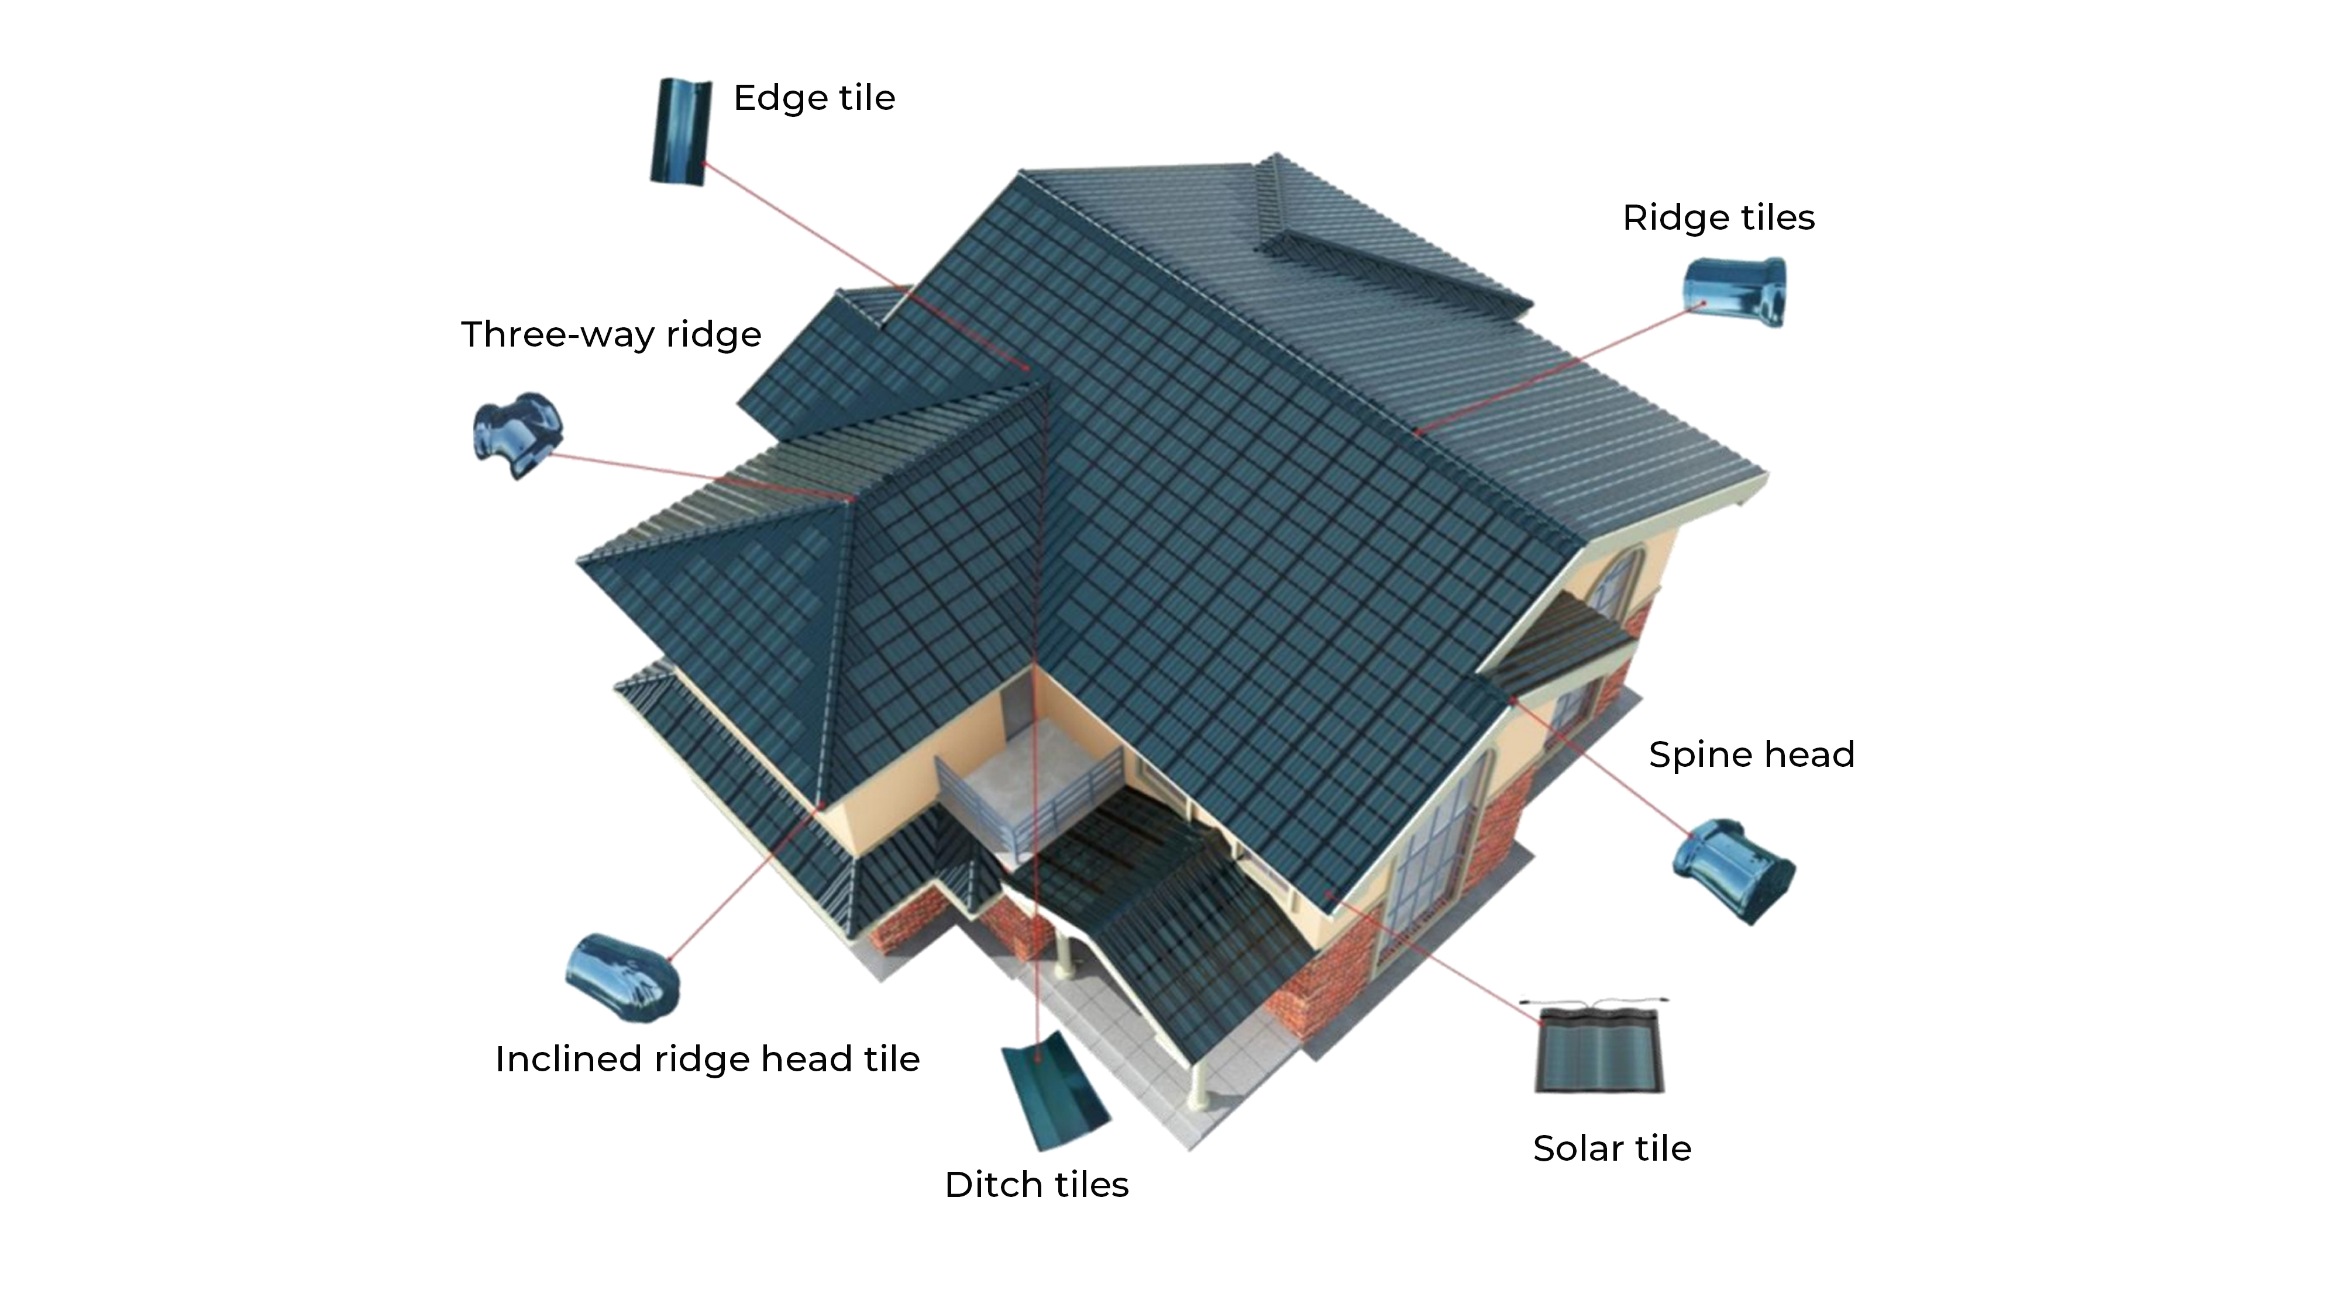
3.Installation Process
For Photovoltaic Three arch TangTile
Convenient/Fast/Safe/Reliable

Slide 17
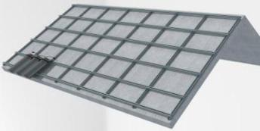
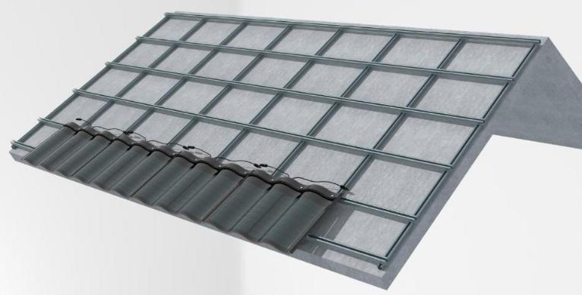
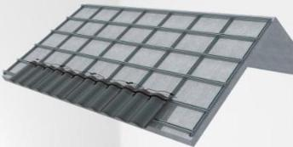
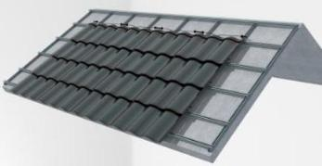
Installation steps of Three arch TangTile
Easy installation and good durability
TangTile has fne sealing performance as being waterproof, fre-proof and wind-proof
It has superior performance and long durability.
Installation Order, From left to right, down to up
The upper and lower TangTiles are overlapped with 85mm, and 25,34mm edge safety zone are kept to ensure no water leakage and pressure into batteries.

Slide 18
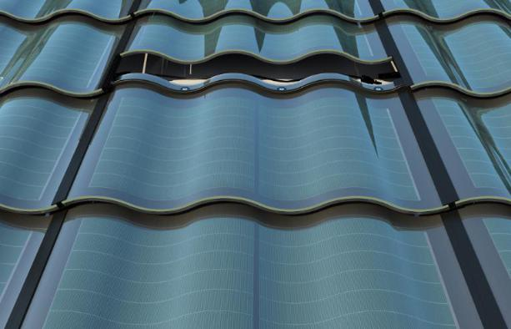
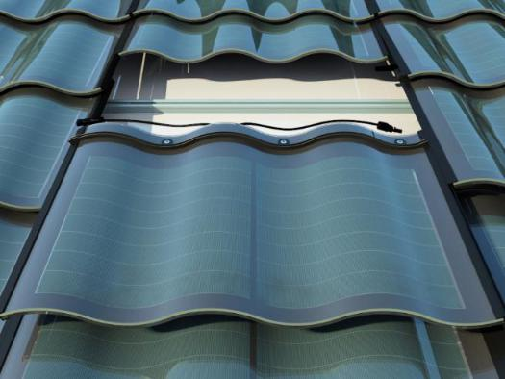
Easy replacement and installation
① Push up the TangTile piece to be replaced
② Take off the TangTile to be replaced

Slide 19
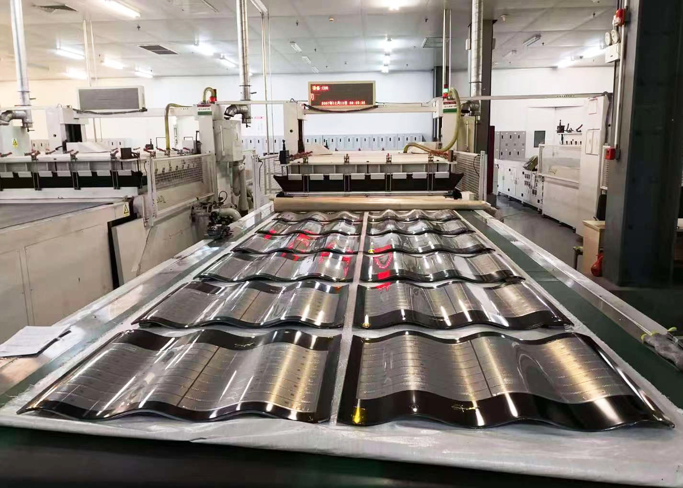
ProductionScene

Slide 20
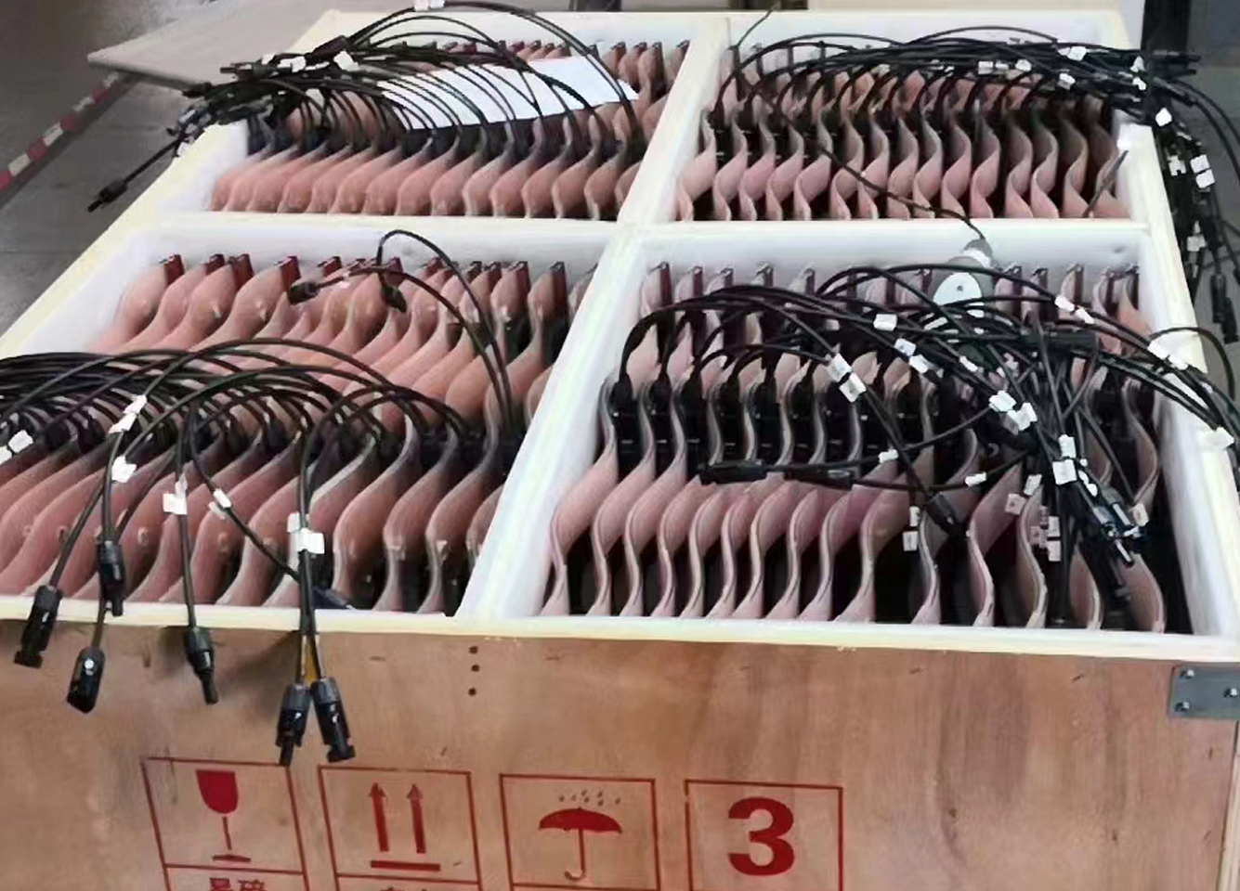
ShippingScene

Slide 21
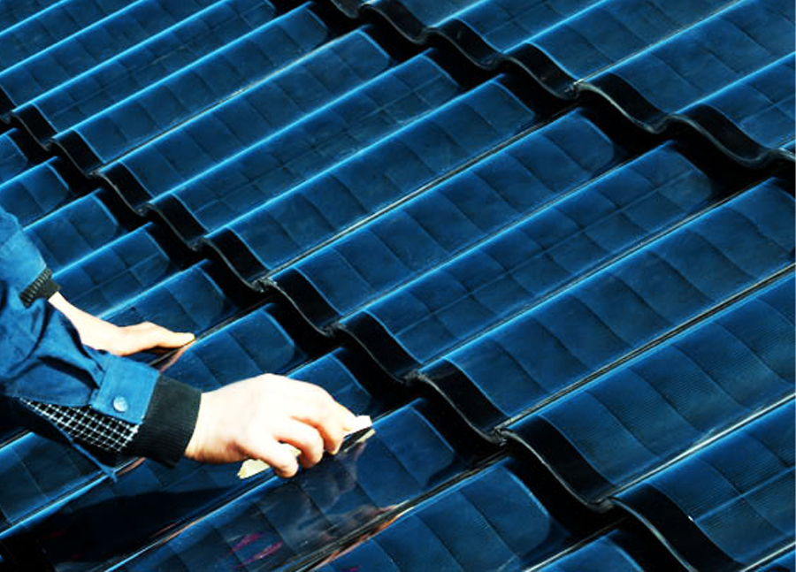
Installation Scene

Slide 22
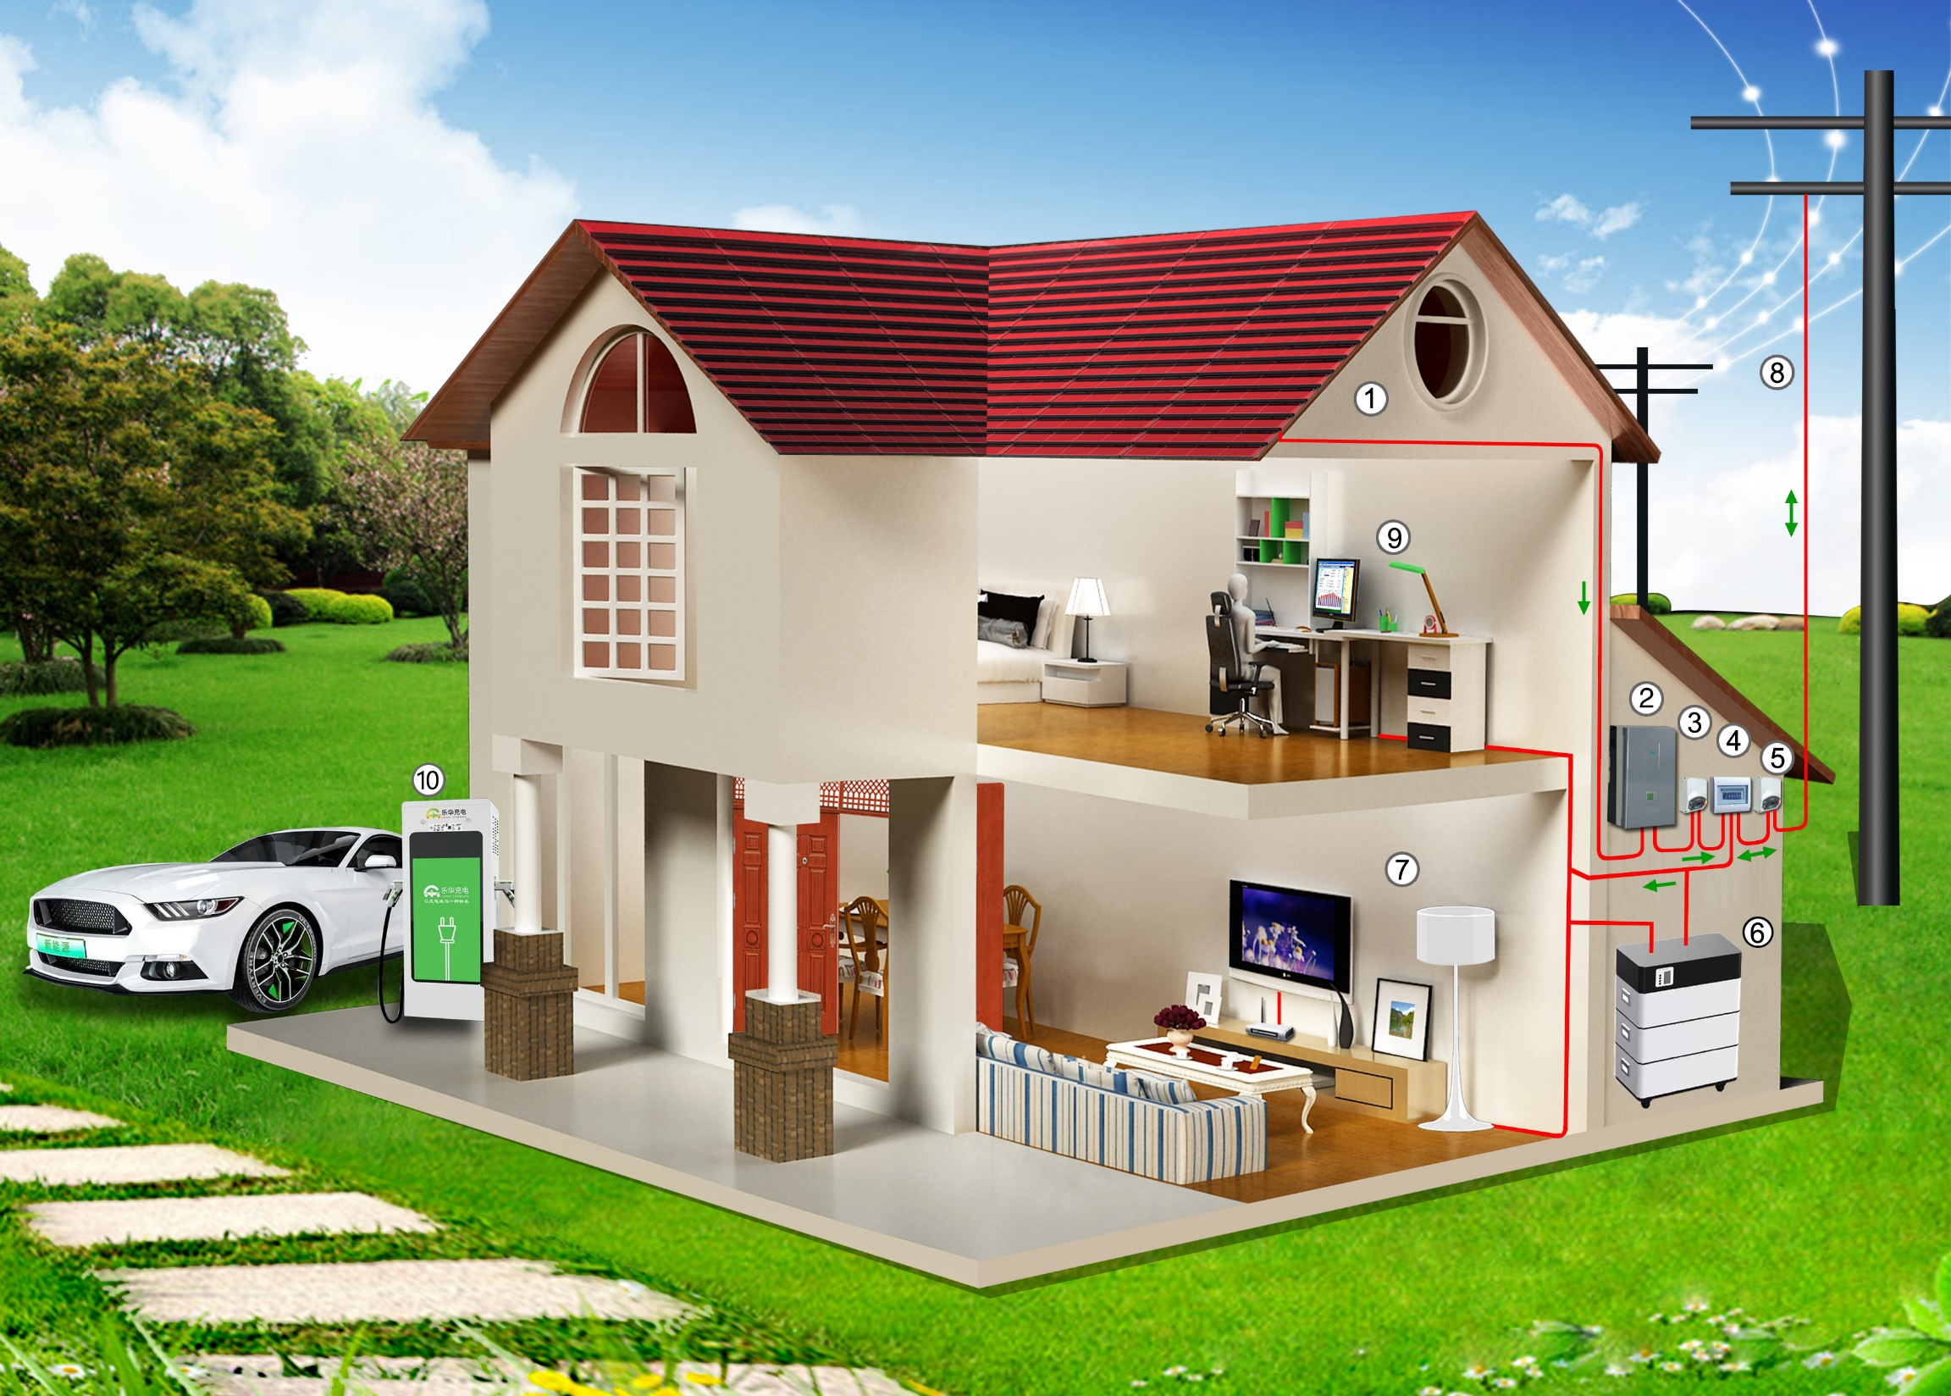
4. Tangtile Power System Diagram
Green Photovoltaic
Energy Independence
Photovoltaic system Composition
Flat photovoltaic tile
(Photovoltaic module)
Photovoltaic inverter
Metering meter
Ac junction box
Smart meter
Household energy storage
Household load
Power grid
System monitoring
Car charging pile

Slide 23
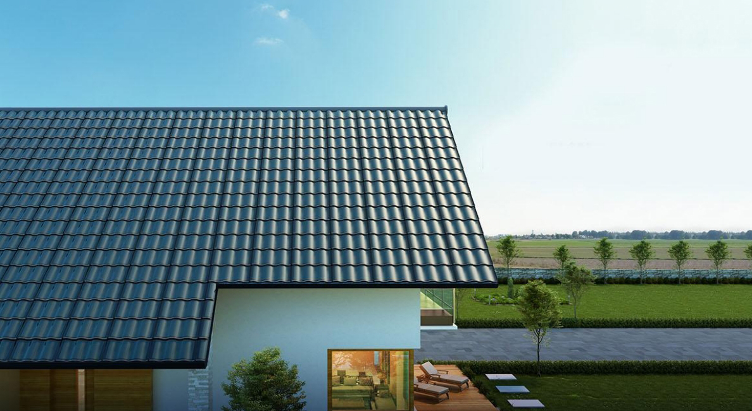
5. Application scenarios of Tangtiles
Integrating modern technology into architecture to make it more beautiful and energy-efficient

Slide 24
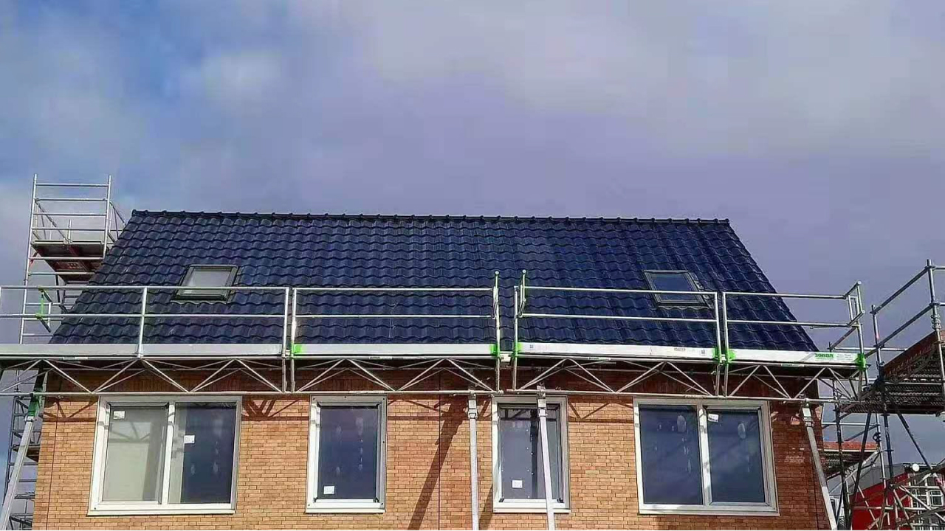
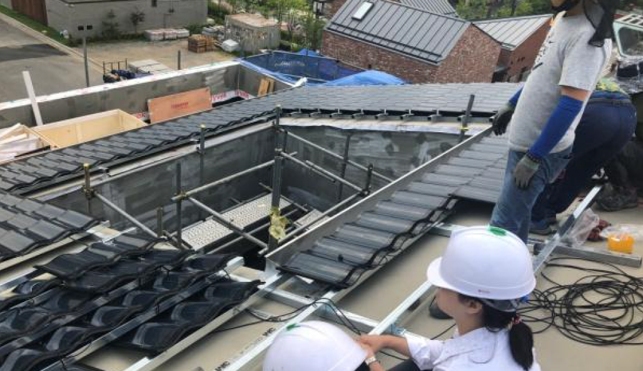
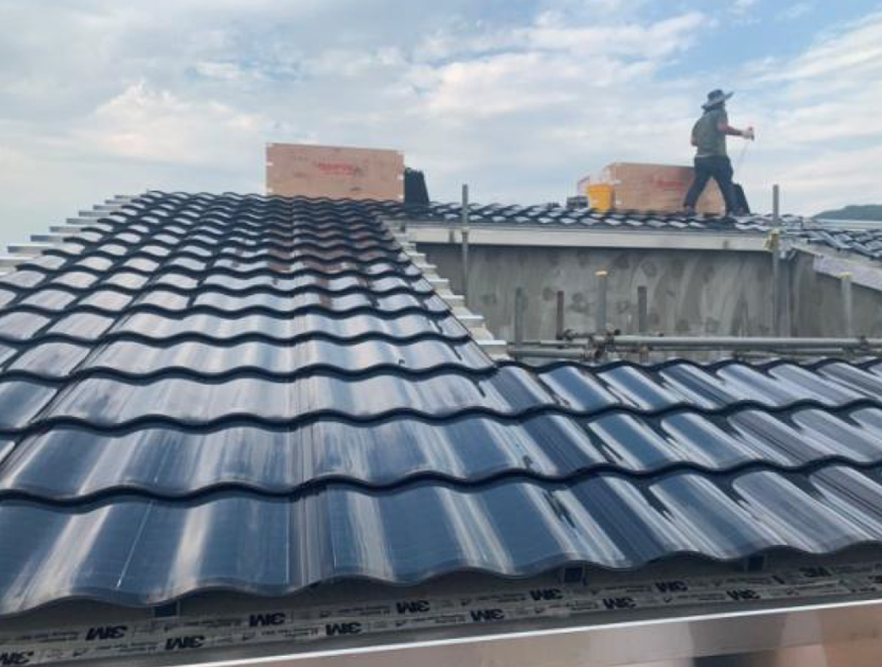
Tourist Of Old Houses

Slide 25
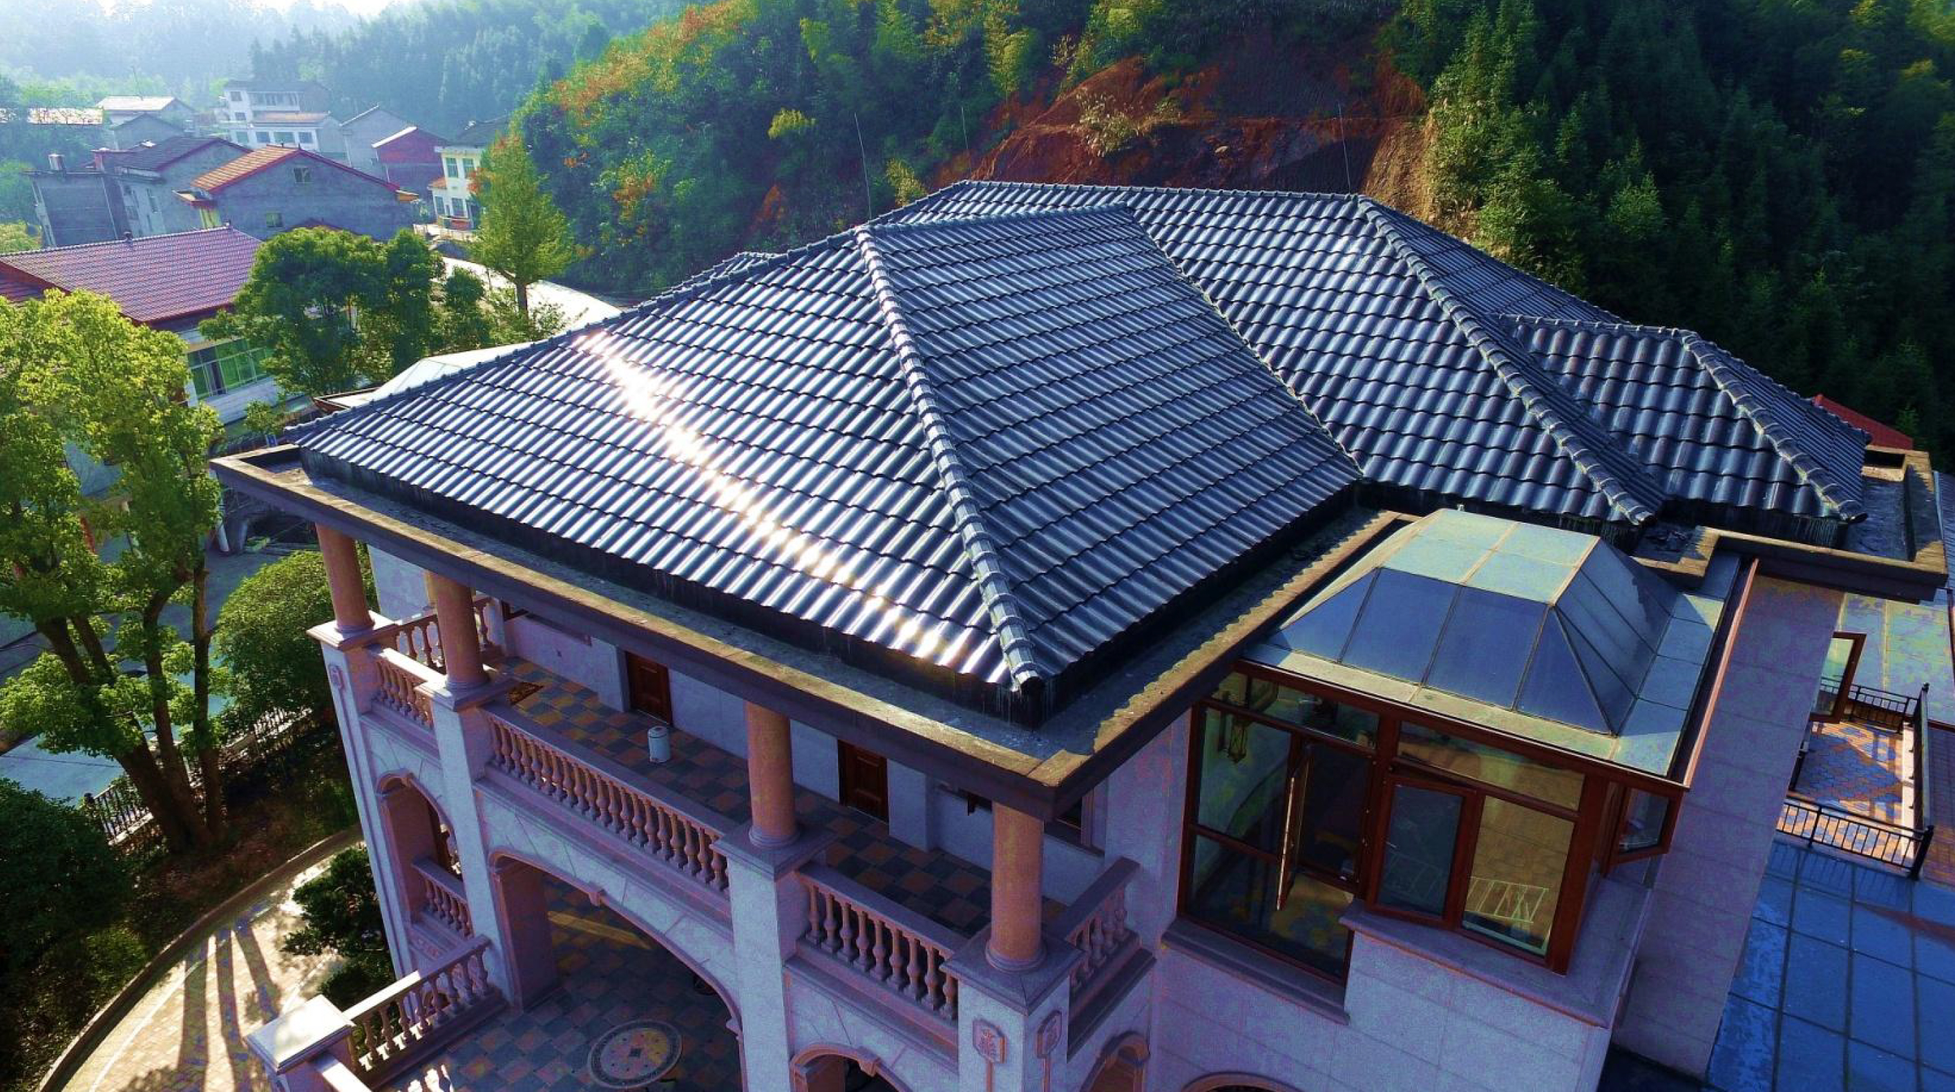
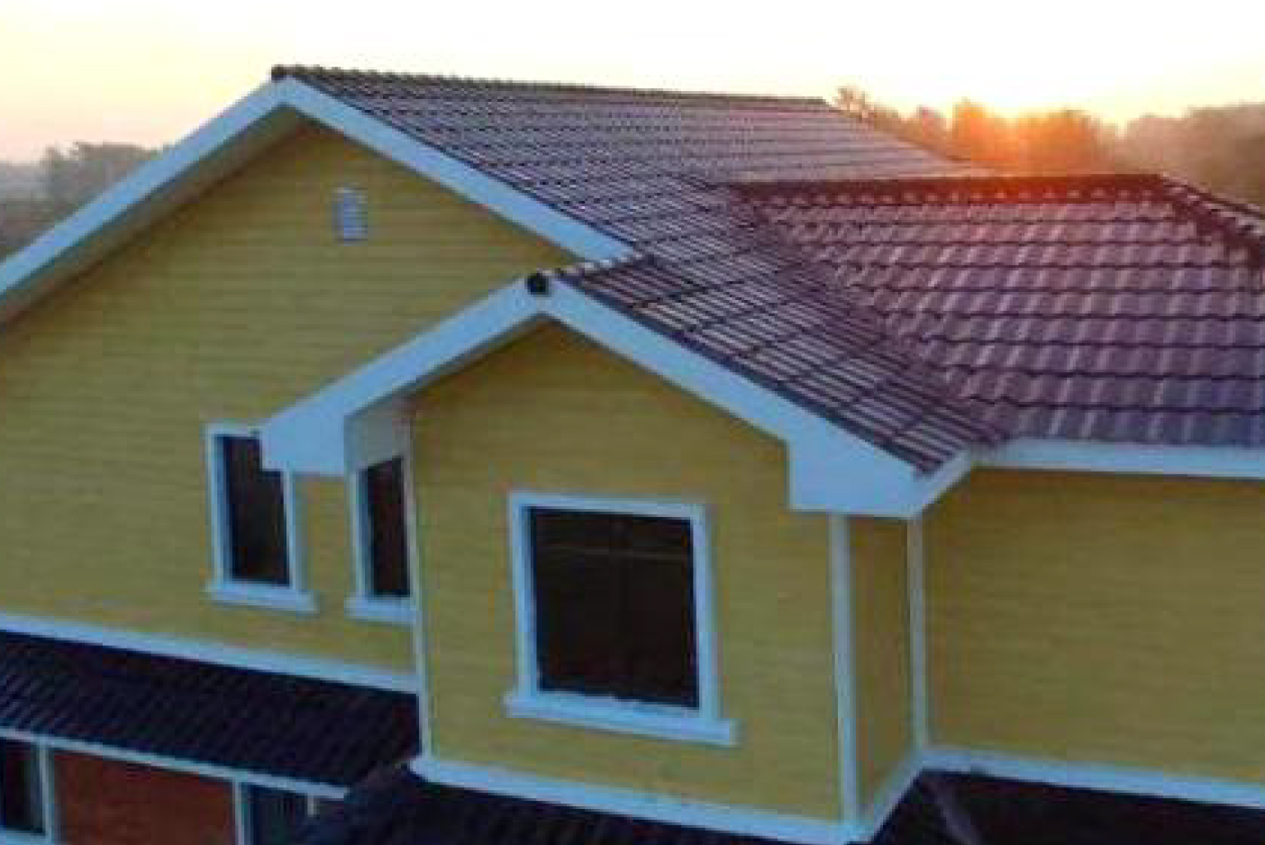
Villa
Notes:
屋面瓦的年限一般为15年，这对屋面瓦的更换带来很大不便。集美观和发电于一体，使用年限30年以上，解决了屋面使用年限的问题。 2、以传统陶土瓦为例，要保证屋顶的正常使用，每20 年需更换一次瓦片，意味着再投入一次资金。的使用寿命可达到传统屋顶材料20 年的两三倍，提供终身质保，意味着用户将在房屋的全生命周期内无需再次更换瓦片，一次投入安心无忧，进一步提升了的使用价值。
超生态：无噪音，零排放，零耗能

Slide 26
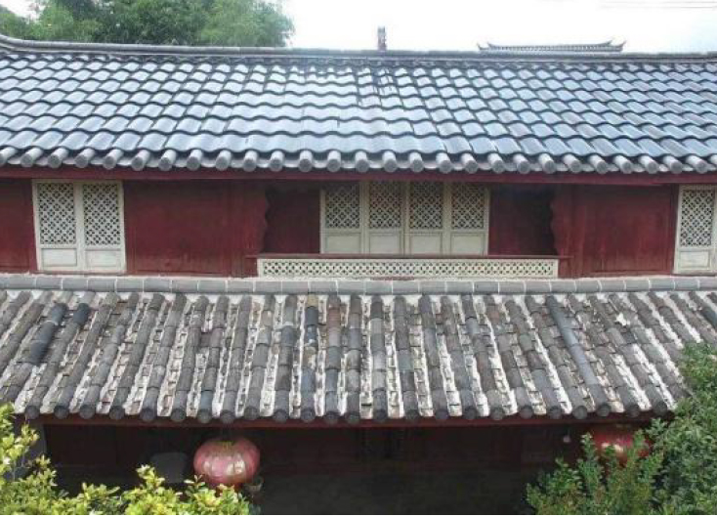
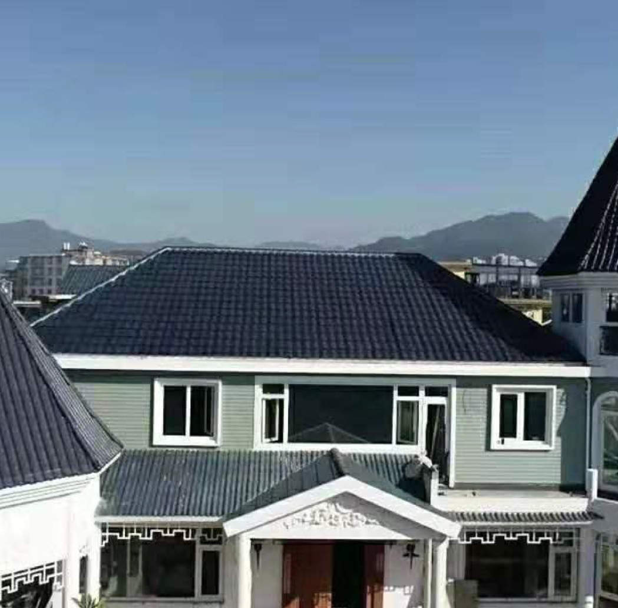
Castles And Churches

Slide 27
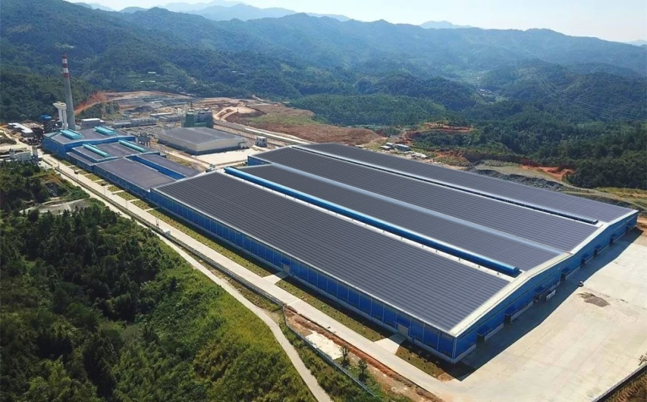
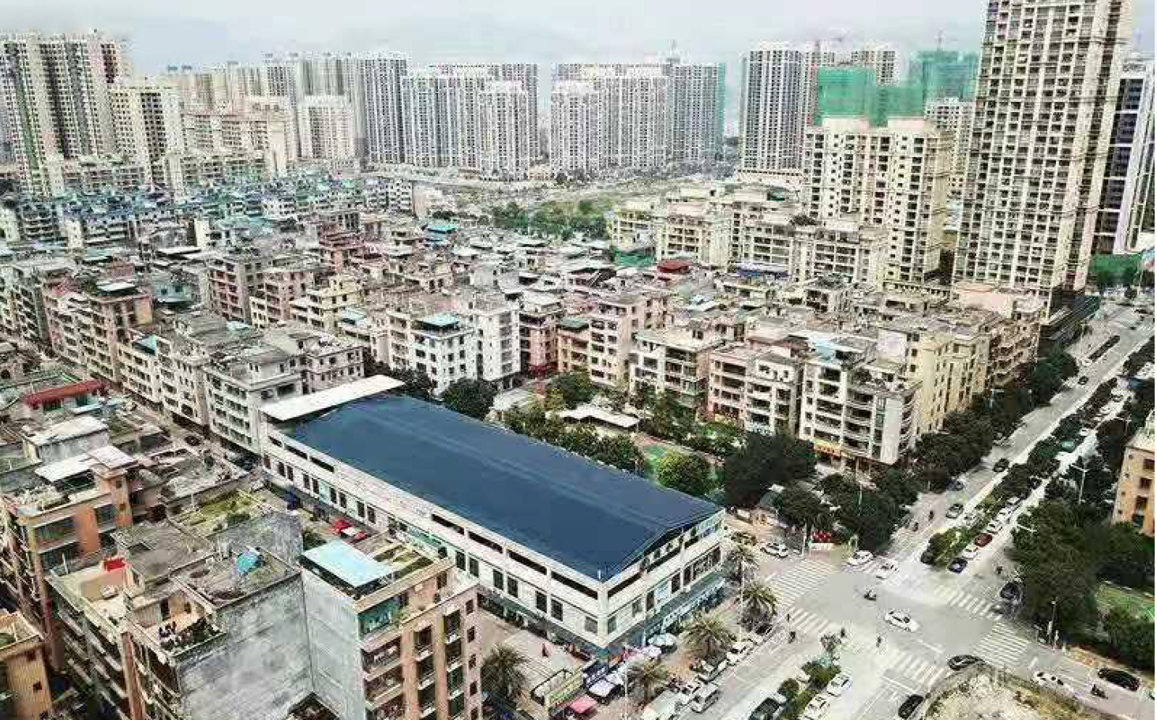
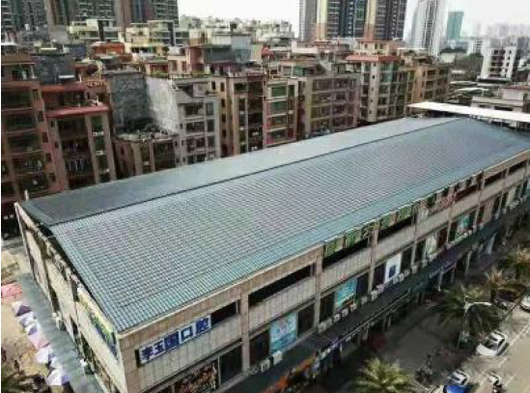
Factory Roof Renovation
Notes:
屋面瓦的年限一般为15年，这对屋面瓦的更换带来很大不便。集美观和发电于一体，使用年限30年以上，解决了屋面使用年限的问题。 2、以传统陶土瓦为例，要保证屋顶的正常使用，每20 年需更换一次瓦片，意味着再投入一次资金。的使用寿命可达到传统屋顶材料20 年的两三倍，提供终身质保，意味着用户将在房屋的全生命周期内无需再次更换瓦片，一次投入安心无忧，进一步提升了的使用价值。
超生态：无噪音，零排放，零耗能

Slide 28
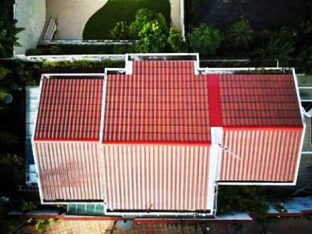
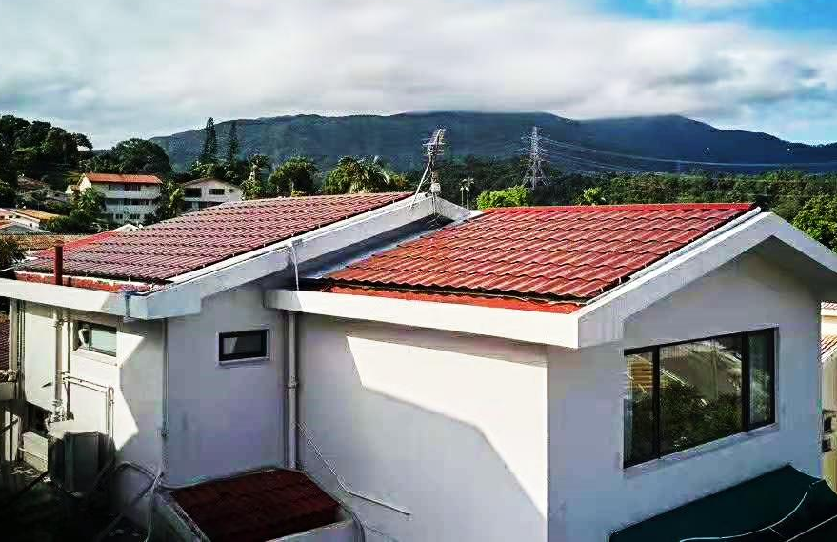
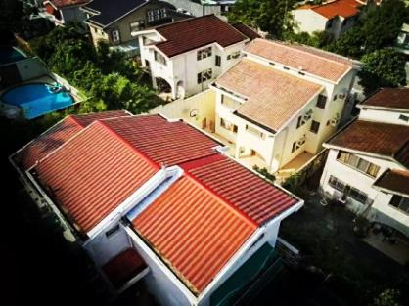
Hongkong

Slide 29
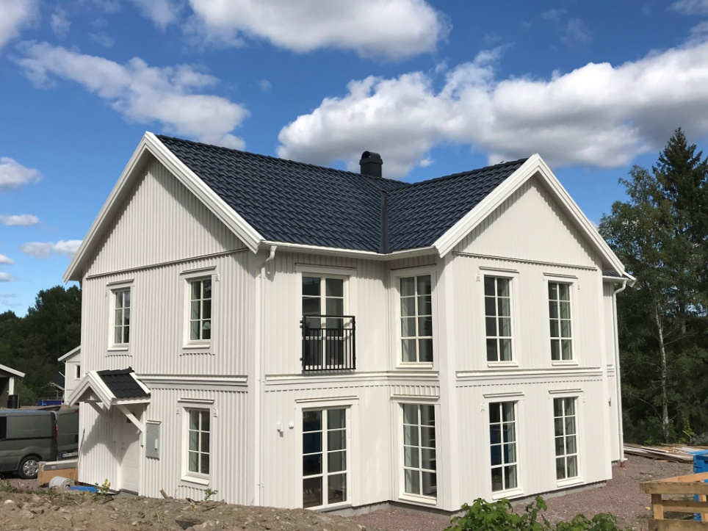
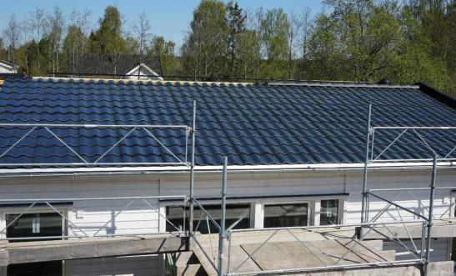
Sweden
Sweden①
Product：Curved TangTile
Capacity：5.2kw
Sweden②
Product：Curved TangTile
Capacity：5.7kw
Sweden
Product：Curved TangTile
Capacity：6.2kw
Sweden③
Product：Curved TangTile
Capacity：6.2kw
Sweden④
Product：Curved TangTile
Capacity：6.6kw

Slide 30
Denmark
Czech Republic

Slide 31
Thailand
Vietnam

Slide 32
Japan

Slide 33
T H A N K Y O U

